Slide 1

Exploring the Evolutionary History of Nitrogenase’s G Subunit
Brooke Carruthers
Dr. Betül Kaçar, Dr. Amanda Garcia
AZ NASA Space Grant Symposium 04/23/2022

Slide 2
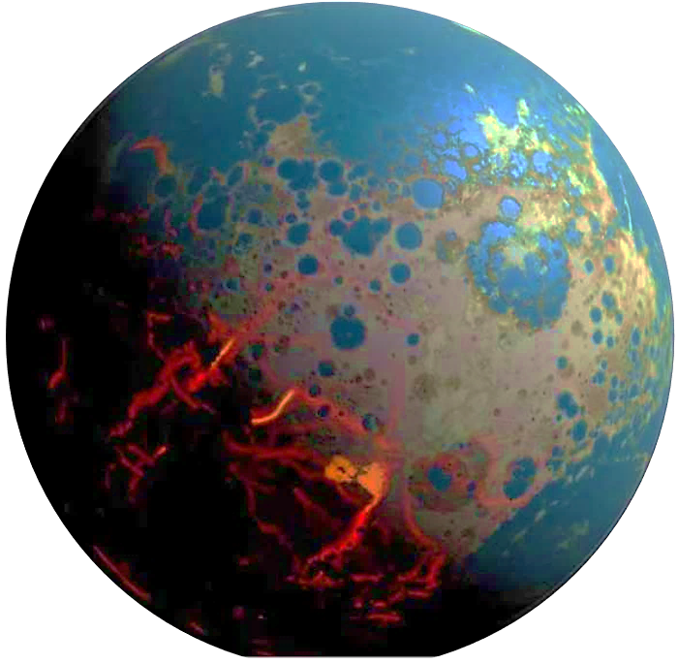
Early Earth was an alien planet!
Ni
Cu
V
Mo
Zn
Fe

Slide 3
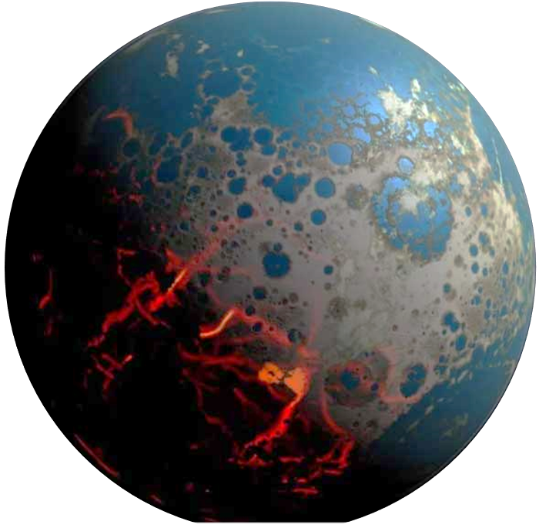

How did metal use by biology change over time?
Why are some metals selected over others?

Slide 4

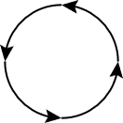
The evolution of Biogeochemical Cycles can inform our understanding of how life co-evolved with the environment
Mo
V
Life
Environment
Fe

Slide 5
N₂
Nitrogen Fixation makes nitrogen available to life!
N-fixation is accomplished by a single family of enzymes:
Nitrogenases
NH₃
NO₃
Without Nitrogenases, we would not have life as we know it!
Biomolecules

Slide 6
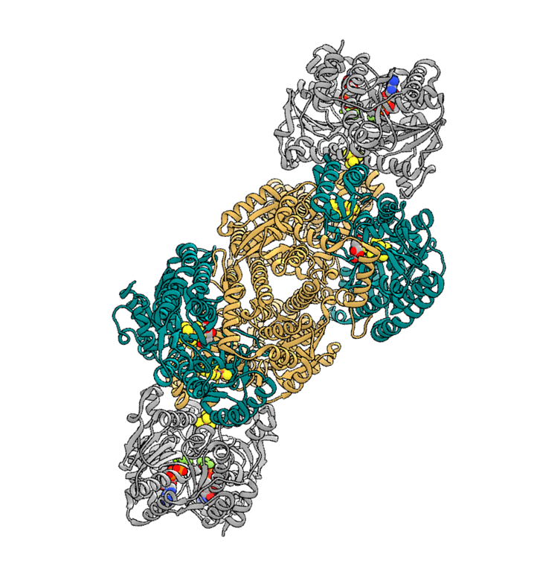
Nitrogenase is the only enzyme that catalyzes the very difficult reaction of N₂ to NH₃!
Does so by using a metal cofactor
H
H
N₂
Metal cofactor!
D
K
Mo
The most common form of nitrogenase has a Molybdenum atom in the cofactor
NH₃

Slide 7
The two later-evolved, alternate nitrogenases have a different metal in their cofactor
H
H
H
H
Alternatives also have an extra protein subunit!
The G subunit is essential to the N2–reducing ability of the alternatives…but not for Mo-nitrogenase (Waugh et al., 1995)
Same reaction, different metals…how and why?
G
G
K
D
K
D
V
Fe
Vanadium
Iron
(Garcia et al., 2020)

Slide 8
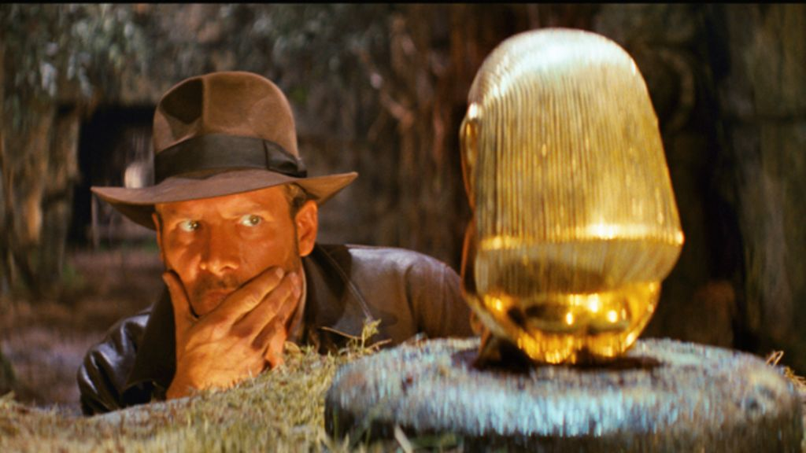
Does the G subunit play a role in conferring metal specificity to nitrogenases?
H
H
H
H
G
New metal usage??
D
D
K
K
?
Evolution!
“Molecular fossil hunting” to reconstruct this series of biological events that occurred early in Earth’s history for this essential enzyme

Slide 9

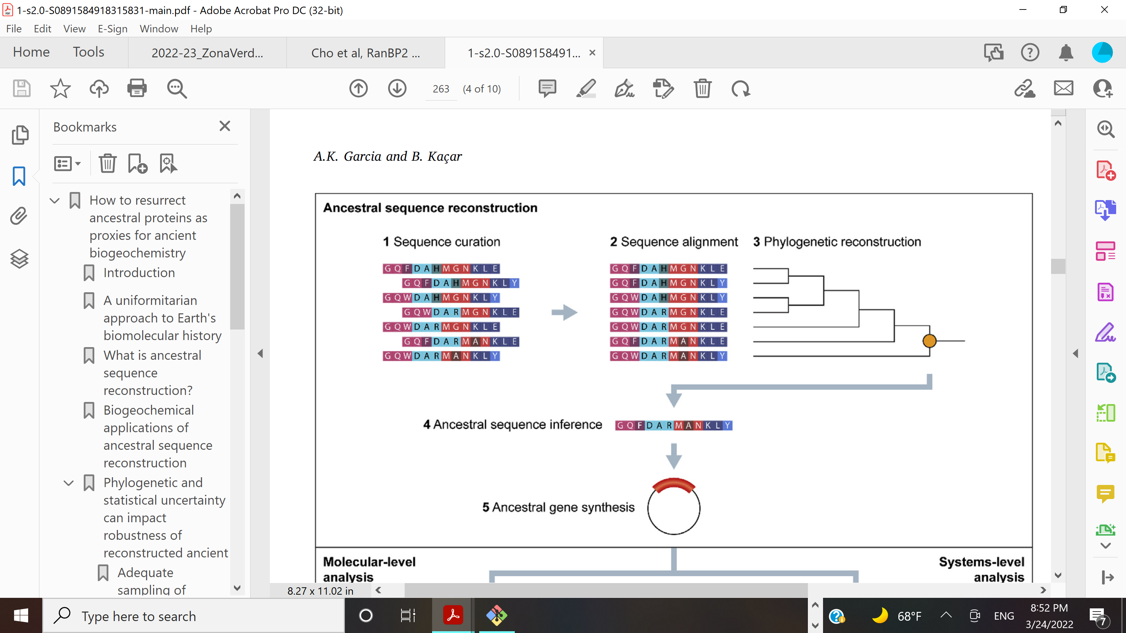



We reconstructed the evolutionary path of the G subunit and inferred its ancestors
Ancestral sequence inference
In the process of computationally analyzing the ancestral sequences
(Garcia & Kaçar, 2019)

Slide 10

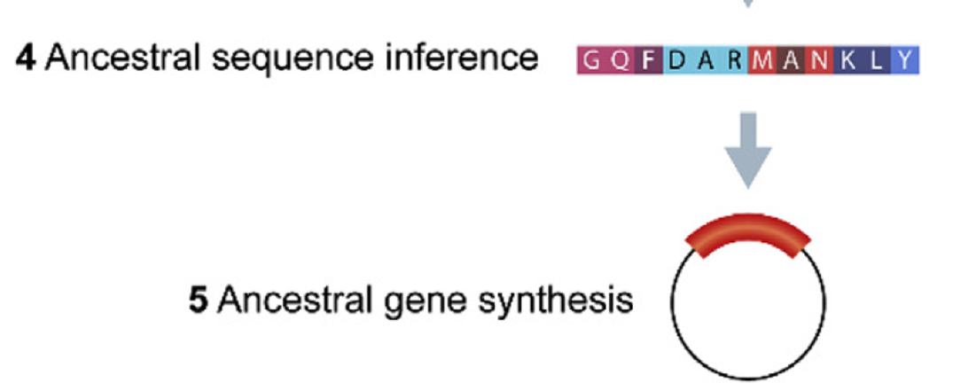

Next step is to resurrect the ancestral proteins in the lab!
Ancestral sequence inference
Ancestral gene synthesis
(Garcia & Kaçar, 2019)

Slide 11
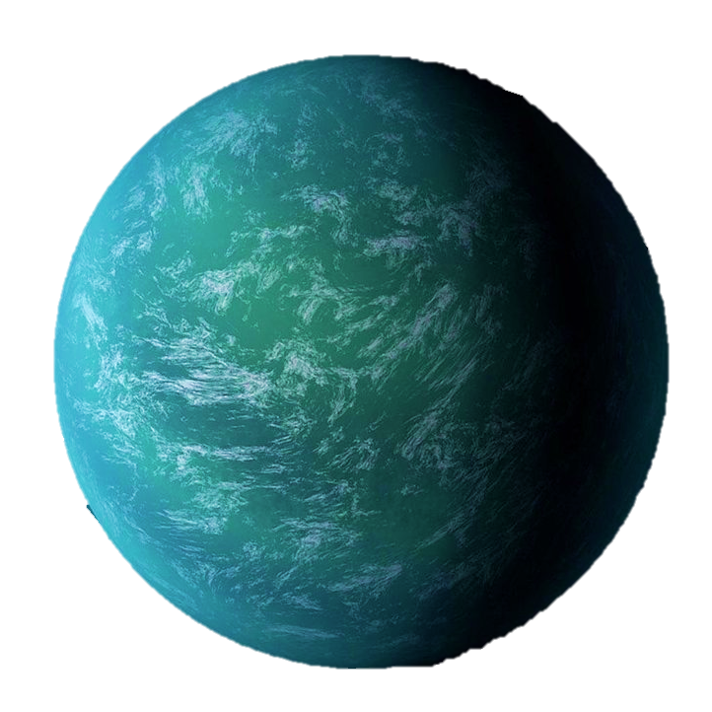

These findings can inform our understanding of how similar metabolisms might evolve with other planetary environments
Mo
Fe
V

Slide 12
Acknowledgements
Betül Kaçar & Kaçar Lab Team
Arizona Space Grant Consortium
Michelle Coe and Chandra Holifield-Collins
NASA Center for Early Life and Evolution, Madison, WI
Amanda Garcia
Bruno Cuevas-Zuviría

Slide 13
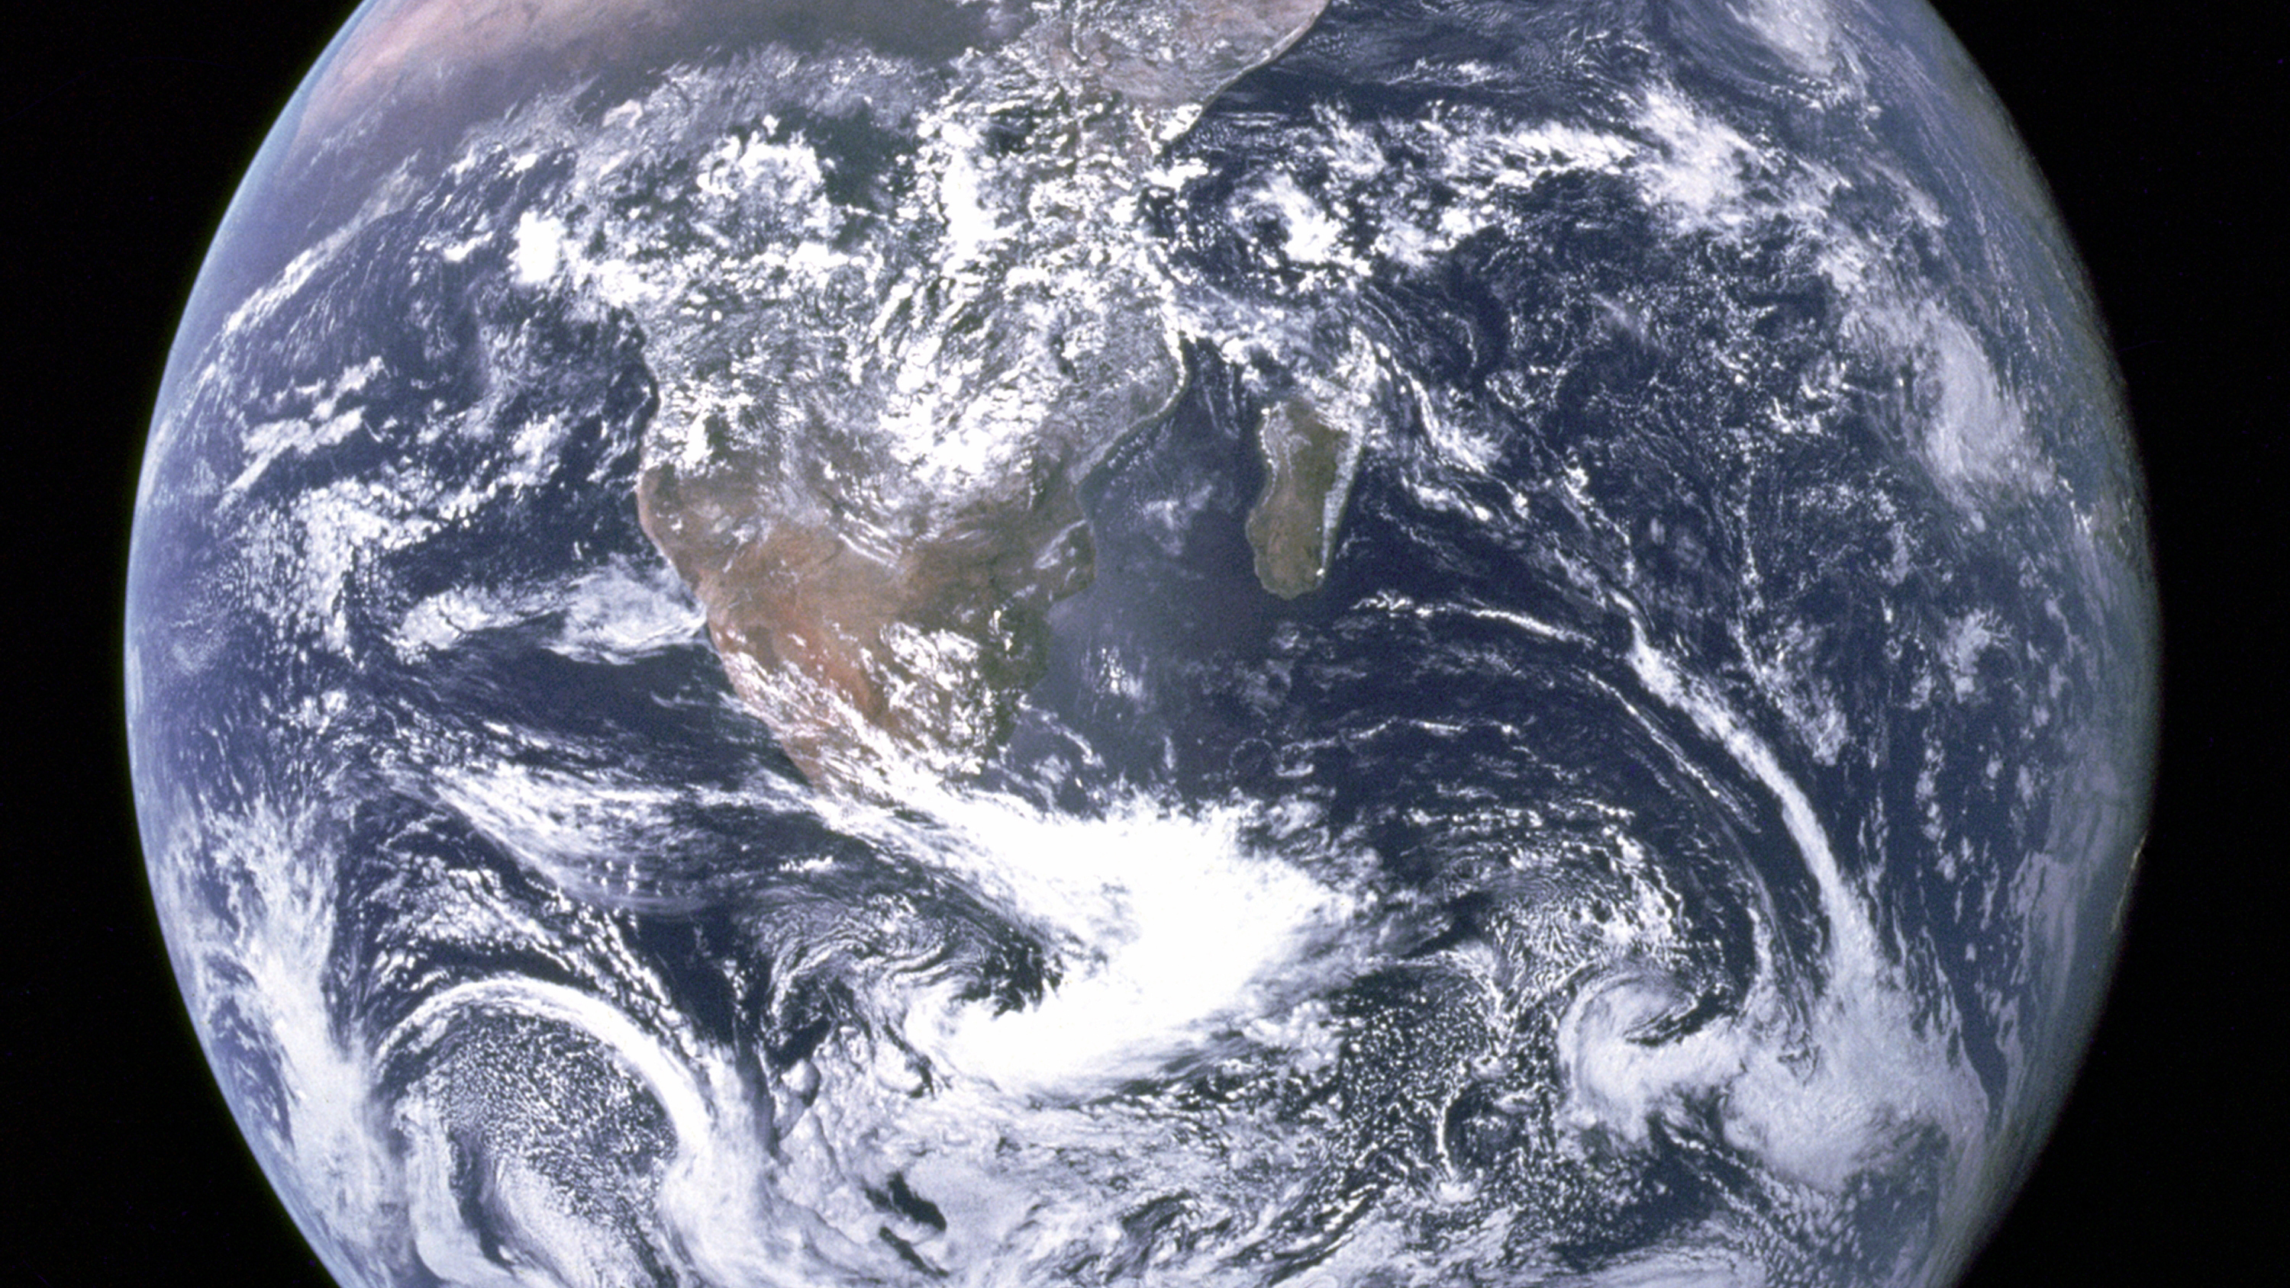
Thank you!

